Slide 1
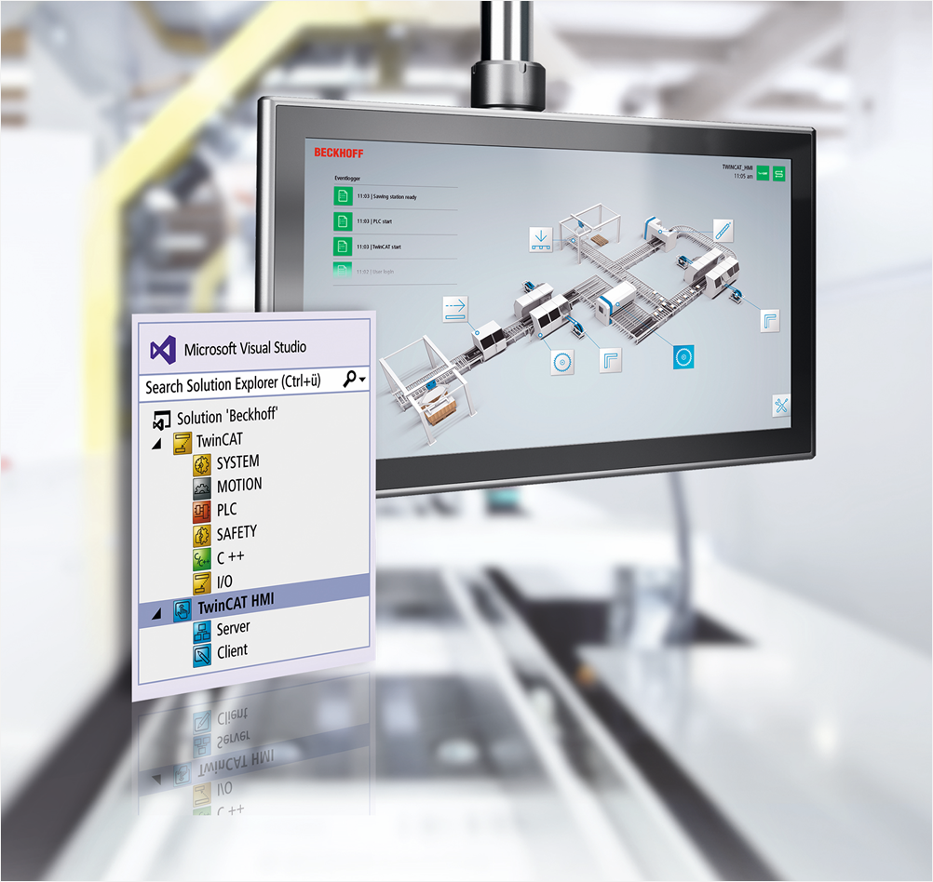
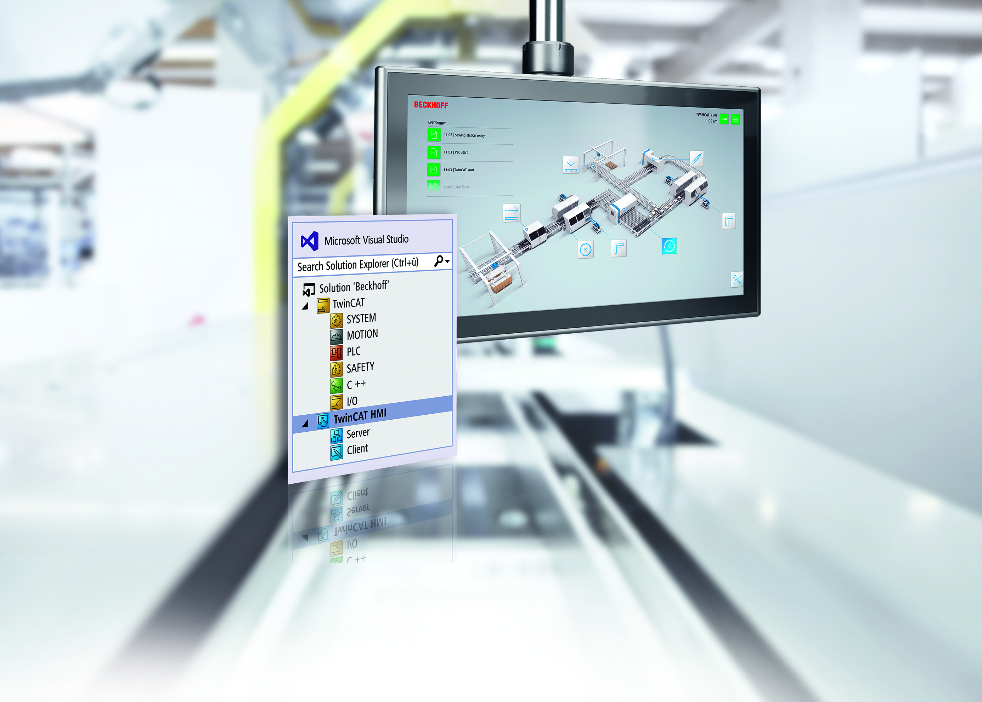
TwinCAT HMI – What‘s New?

Slide 2
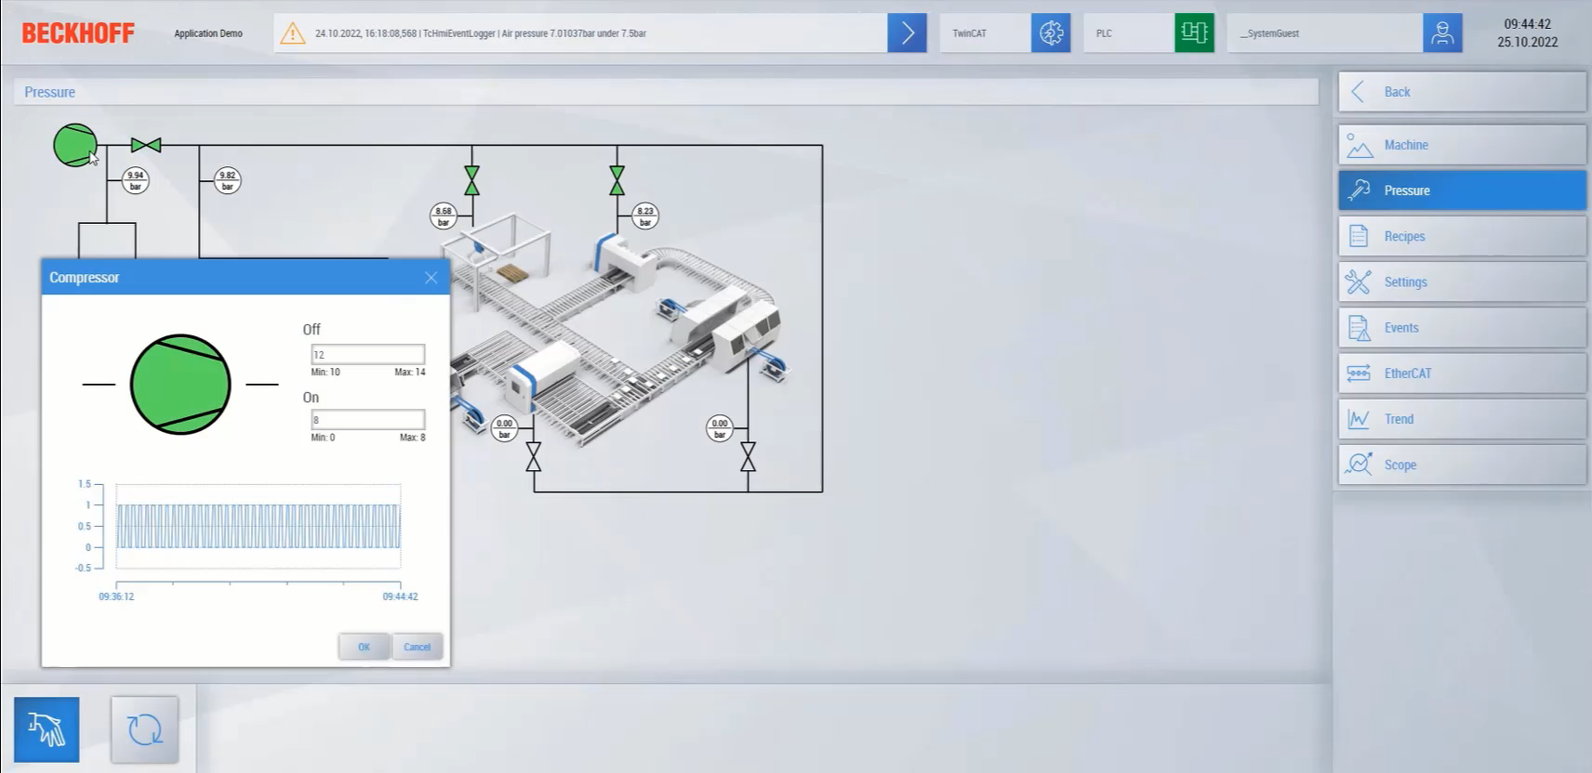
TwinCAT HMI What‘s New?
PopUp Controls
Opened and closed using functions triggered from other controls
Target file can be chosen dynamically
Draggable

Slide 3
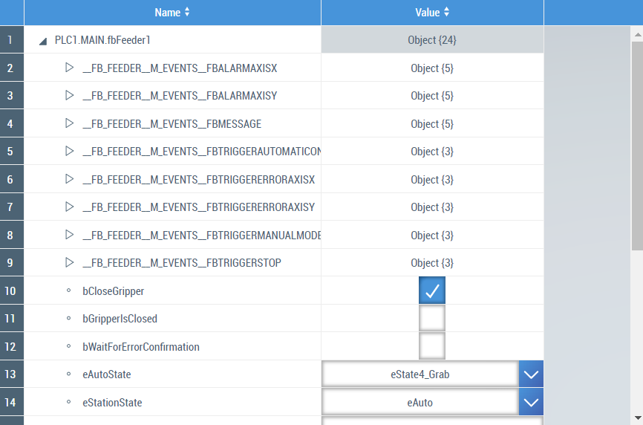
TwinCAT HMI What‘s New?
Object Browser
Read complex symbols from PLC
Tree structure displayed on HMI
Values of each nested parameter can be read / written

Slide 4
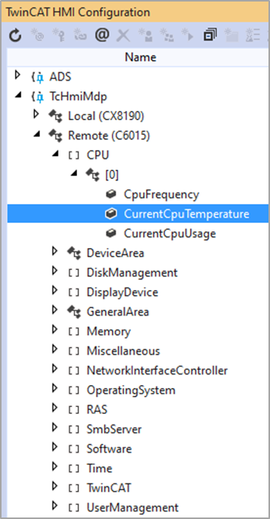
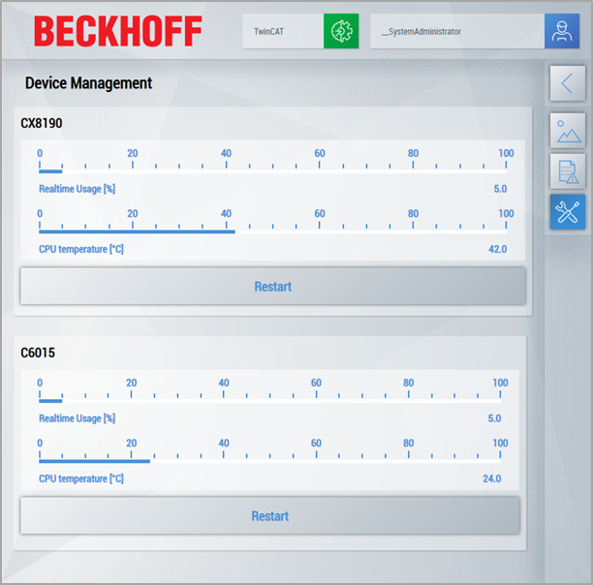
TwinCAT HMI What‘s New?
MDP Server Extension
Access to Modular Device Profile (MDP) of Beckhoff IPC Diagnostics
Can monitor PC status – CPU load, temperature etc. without PLC

Slide 5
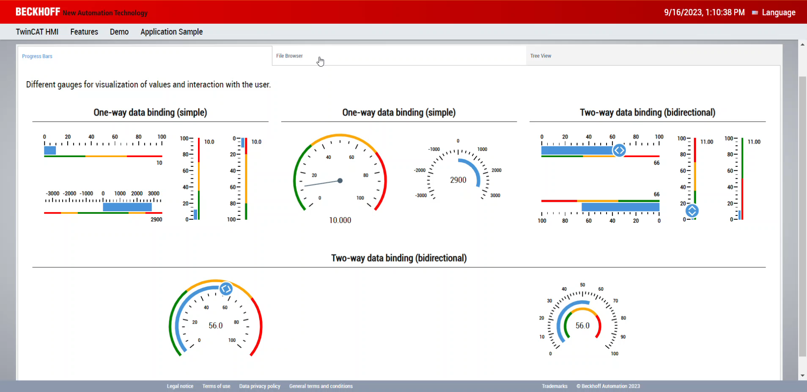
TwinCAT HMI What‘s New?
Tab Navigation
Control for page switching
Built-in tabs used to load different pages

Slide 6
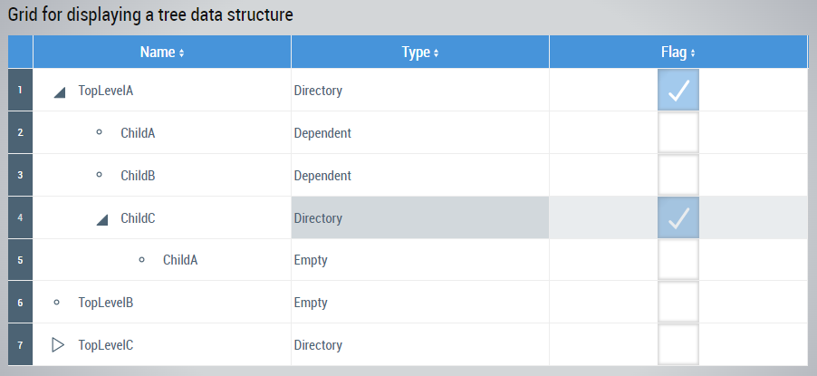
TwinCAT HMI What‘s New?
Tree View
Multi-column view for displaying data
Collapsible nodes

Slide 7
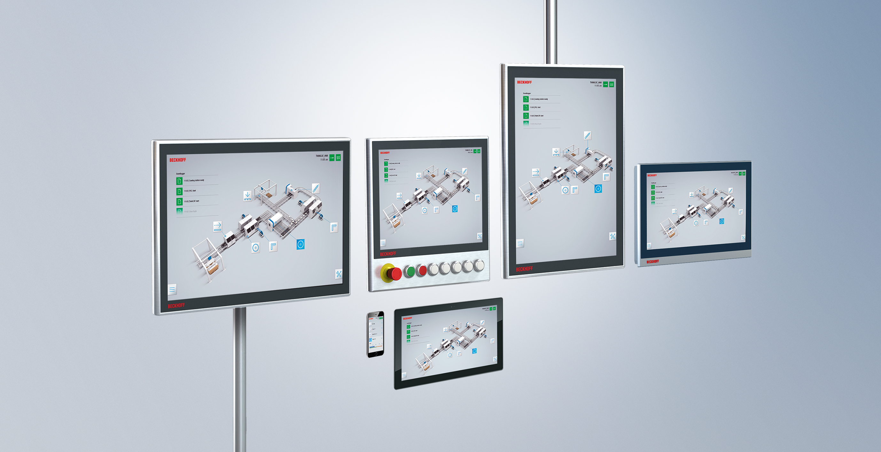
TwinCAT HMI Questions?

Slide 8
Contact
Beckhoff Automation GmbH & Co. KG
Headquarters
Huelshorstweg 20
33415 Verl
Germany
Phone: +49 5246 963-0
Fax: +49 5246 963-198
E-Mail: info@beckhoff.com
Web: www.beckhoff.com
© Beckhoff Automation GmbH & Co. KG
All images are protected by copyright. The use and transfer to third parties is not permitted.
Beckhoff®, TwinCAT®, EtherCAT®, Safety over EtherCAT®, TwinSAFE®, XFC® and XTS® are registered trademarks of and licensed by Beckhoff Automation GmbH. Other designations used in this presentation may be trademarks whose use by third parties for their own purposes could violate the rights of the owners.
The information provided in this presentation contains merely general descriptions or characteristics of performance which in case of actual application do not always apply as described or which may change as a result of further development of the products. An obligation to provide the respective characteristics shall only exist if expressively agreed in the terms of contract.
Notes:
8

